Slide 1
Video Recommendation Engine using MMoE
Presented by:
Gulnara Timokhina,
Mirsaeid Abolghasemi
Poornapragna Vadiraj
Varun Bhaseen

Slide 2
Introduction
Recommendation Engine

Slide 3
Purpose and Objective
Purpose
The primary purpose of this project is to create a recommendation engine using MMoE (Multi gate Mixture of Experts) for a recommendation.
Create a web application
Objectives
Create a web application for recommending Videos
Colab to train the MMoE model to give scores for ranking
Using TFX as ML pipeline

Slide 4
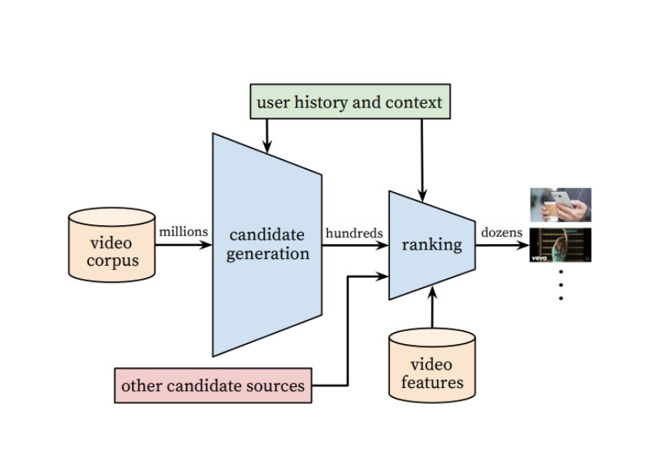
Recommendation System Architecture
Single Task Recommendation System.
A Recommendation system has two components:
Candidate Generation
Ranking List
For any recommendation engine it needs to know the user history, their likes, dislikes, user clicks, time spent on a video or content etc. to determine the best candidates and carry out the most appropriate ranking of a content that user will click and watch

Slide 5
Challenges in Recommendation System
There are often different and sometimes conflicting objectives which we want to optimize for. For example, we may want to recommend videos that users rate highly and share with their friends, in addition to watching
There is often implicit bias in the system. For example, a user might have clicked and watched a video simply because it was being ranked high, not because it was the one that the user liked the most. Therefore, models trained using data generated from the current system will be biased, causing a feedback loop
Another main challenge of recommendation systems is scalability.

Slide 6
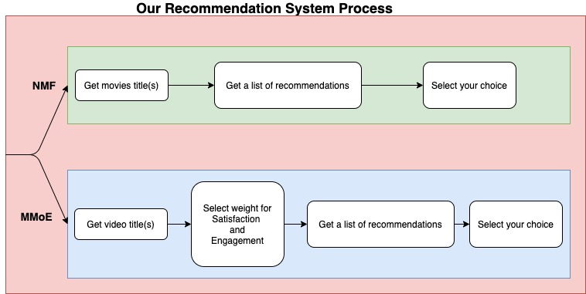
Recommendation System Web app Architecture
We are using NMF(Non-negative matrix factorization for recommendation systems) for getting ranking a list of movies from candidate lists
MMoE(Multi-gate Mixture-of-Experts) is used to rank the videos from YouTube dataset based on queries given by user

Slide 7
Multi Gate Mixture of Experts
MMoE based ranking system

Slide 8
Two main challenges in video recommendation systems:
Multiple Objective Functions: There are two common objective functions that may create a conflict and should be optimized:
Engagement Objectives: These objectives can be measured using dataset on clicks, time spent of the user while watching the recommended video, etc.
Satisfaction Objective: These objectives can be measured by dataset in likes, shares, comments, rating, etc.
Both these objectives contain:
binary classification tasks (click or not, like or not, etc.)
regression tasks (time spent, rating given, etc.)
Removal of Implicit Bias: For training the model, the used dataset contains some implicit bias:
The reason is because a user historically might have clicked and watched a video simply because it was being ranked high, not because it was the one that the user liked the most.
So, if the model is trained using such data, it will produce biased non-optimal recommendations which the user might not like.

Slide 9
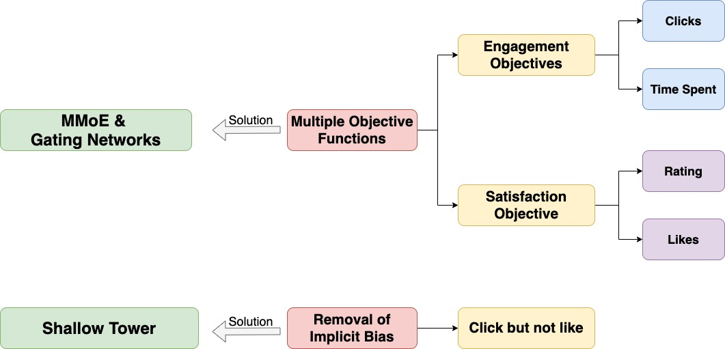
Two main challenges in video recommendations system and solutions

Slide 10
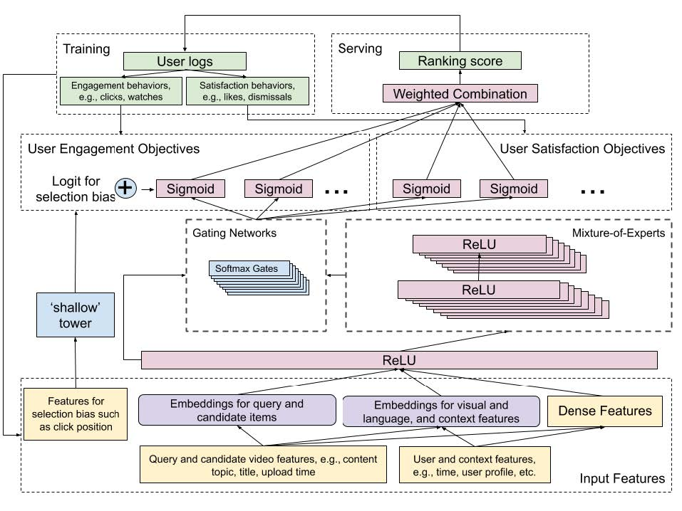
MMoE & Gating Network architecture:
MMoE structure is a combination of Multi-Layer Perceptrons followed by ReLU activations.
There are experts in the MMoE layer which each of them are to learn a different feature of the input data.
The output of the MMoE layer goes to a Gating Network.
The output of the Gating Networks and the output of the shared hidden layer are inputs for the objective functions such as engagement and satisfaction.
A sigmoid activation function represents each objective function.

Slide 11
Shallow Tower architecture:
Using implicit feedback data for training because explicit feedback data which are ideal for training are not available or are expensive, might not be ideal as there is a bias in this data.
For this, a shallow tower is introduced into the model architecture.
The shallow tower is trained using features that contribute to the bias like position of the recommendation and tries to predict whether there is a bias component involved in the current instance.
It is removing the selection bias, takes input related to the selection bias, e.g., ranking order decided by the current system, and outputs a scalar serving as a bias term to the final prediction of the main model.
The Shallow tower factorizes the label in training data in two parts the unbiased user utility learned from the main model, and the estimated propensity score learned from the shallow tower.

Slide 12
Our Approach for MMoE
Recommending YouTube videos using MMoE (Multigate Mixture of Experts)

Slide 13
Recommendation Engine
Candidate List
Ranking Generation
Potential candidates using Cosine Similarity
Content Based
Query Entered from user
Using MMoE to support two objectives
Satisfaction Score
Engagement Score
Notes:
We approach the above challenges using the Multi gate mixture of experts. it introduces a shallow tower to model and remove selection bias. The system can handle multiple queries at once
Our recommendation Engine contains two stages:
Candidate Generation
Ranking: Two objectives
Satisfaction Score : satisfaction objectives, such as user liking a video on YouTube, and leaving a rating on the recommendation
Ranking Score: engagement objectives, such as user clicks, and degree of engagement with recommended videos

Slide 14
Candidate List
Using Content based approach to generate candidate list
At the candidate generation stage, we retrieve 50 candidates from a huge corpus. Our ranking system provides a score for each candidate and generates the final ranked list.
At the end, all candidates are pooled into a set and subsequently scored by the ranking system.

Slide 15
Colab Demo

Slide 16
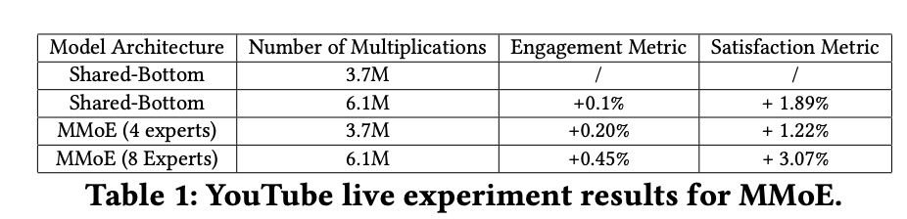
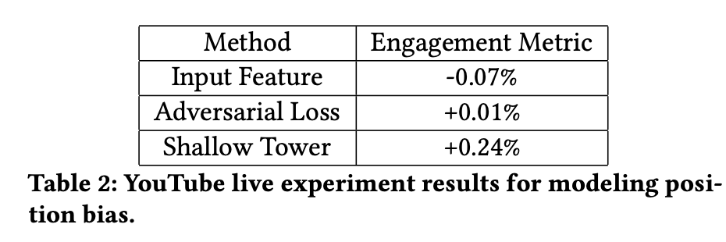
Results from production

Slide 17
Application Demo
Model Deployment
Web Application
Challenge: Bad Data
Challenge: Cold Start
WEB APPLICATION DEMO

Slide 18
TFX Pipelines
ExampleGen ingests and splits the input dataset.
StatisticsGen calculates statistics for the dataset.
SchemaGen examines the statistics and creates a data schema.
ExampleValidator looks for anomalies and missing values in the dataset.
Transform performs feature engineering on the dataset.
Trainer trains the model using TensorFlow Estimators or Keras.
Evaluator performs deep analysis of the training results.
InfraValidator checks the model is actually servable from the infrastructure, and prevents bad model from being pushed.
Pusher deploys the model to a serving infrastructure.
BulkInferrer batch inference on the model with unlabelled examples.
TensorFlow Serving for serving.
 | Completed
 | Work in Progress

Slide 19
Project Management
Trello Board for Project Management
Google Drive for Content Sharing
Zoom for Meeting

Slide 20
Thank you
Questions?

Slide 21
References
https://medium.com/@bhatia.suneet/a-multitask-ranking-system-how-youtube-recommends-the-next-videos-a23a63476073
https://daiwk.github.io/assets/youtube-multitask.pdf
https://dl.acm.org/doi/10.1145/3298689.3346997

